Slide 1
Chapter II
Mathematics: Basics

Slide 2
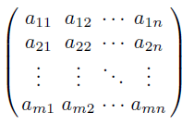
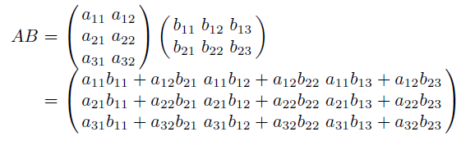
Matrices and Vectors
This chapter delivers an explicit presentation of the basic mathematical techniques, which are needed throughout this book.
m×n matrix
If m = n, the matrix is called square.
Matrix-matrix multiplication
If A’s dimension is l×m and B’s dimension is m×n, AB is an l×n matrix.
2-<number>

Slide 3


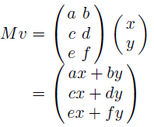


Matrices and Vectors (cont’d)
The typical representation of a 2D vector, (x,y), or a 3D vector, (x,y,z), is called a row vector. Instead, we can use a column vector:
Matrix-vector multiplication
Transpose denoted by M^{T}
A different way of matrix-vector multiplication
Whereas OpenGL uses the column vectors and the vector-on-the-right representation for matrix-vector multiplication, Direct3D uses the row vectors and the vector-on-the-left representation.
2-<number>

Slide 4


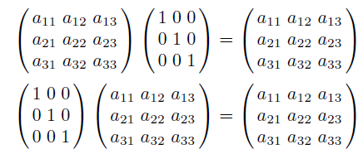
Matrices and Vectors (cont’d)
Identity matrix denoted by I
For any matrix M, MI = IM = M.
If two square matrices A and B are multiplied to return an identity matrix, i.e., AB = I, B is called the inverse of A and is denoted by A⁻¹. By the same token, A is the inverse of B.
Theorems
  (AB)⁻¹ = B⁻¹A⁻¹
  (AB)^{T} = B^{T}A^{T}
2-<number>

Slide 5

Matrices and Vectors (cont’d)
Consider the coordinates of a 2D vector, v:
Its length denoted by ||v||
Dividing a vector by its length is called normalization.
Such a normalized vector is called the unit vector since its length is 1.
The same applies to a 3D vector.
2-<number>

Slide 6
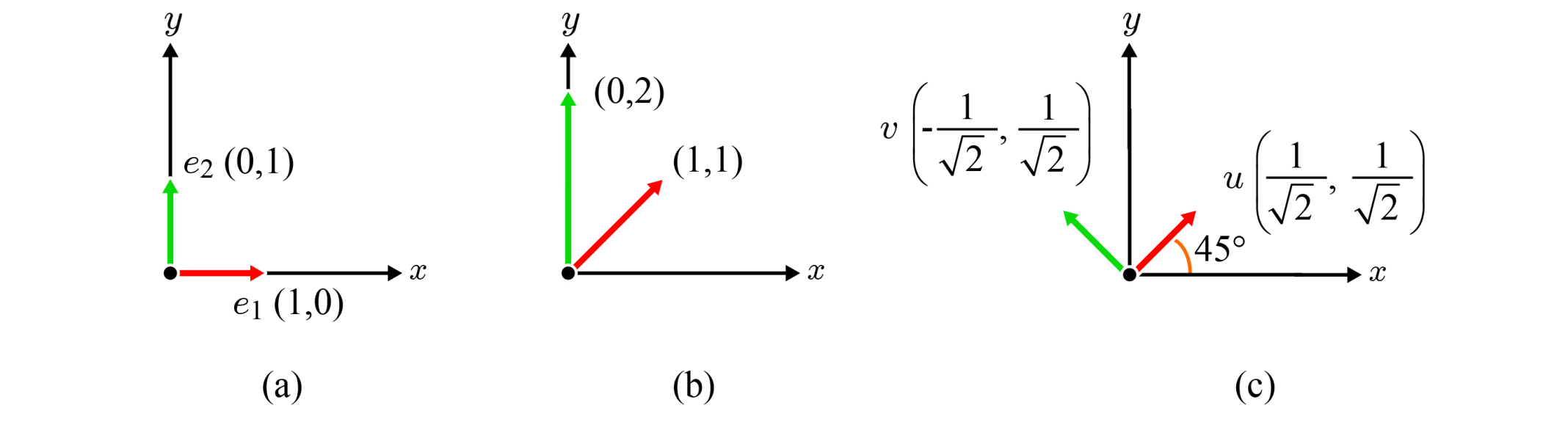
Coordinate System and Basis
Coordinate system = origin + basis
In the 2D space, every vector can be defined as a linear combination of basis vectors. Consider (3,5) for the following three examples.
An orthonormal basis is an orthogonal set of unit vectors.
Throughout this book, we use the terms coordinate system and space interchangeably.
orthonormal
standard
non-orthonormal
non-standard
orthonormal
non-standard
2-<number>

Slide 7
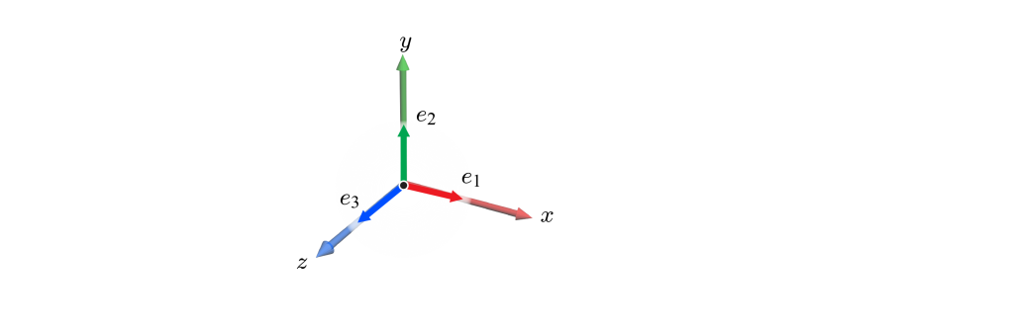
Coordinate System and Basis (cont’d)
3D standard basis, {e₁, e₂, e₃}, where e₁=(1,0,0), e₂=(0,1,0), and e₃=(0,0,1).
It is also orthonormal.
Of course, we can imagine non-standard orthonormal bases.
All 2D and 3D bases presented from now on will be orthonormal.
2-<number>

Slide 8
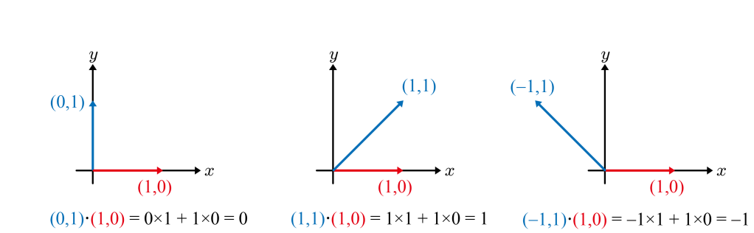
Dot Product
Given two n-dimensional vectors, a and b, whose coordinates are (a₁, a₂, .. , a_{n}) and (b₁, b₂, .. , b_{n}), respectively, their dot product a⋅b is defined to be a₁b₁+a₂b₂+ .. +a_{n}b_{n}.
When the angle between a and b is denoted as θ, a⋅b can be also defined as ‖a‖‖b‖cosθ.
  If a and b are perpendicular to each other, a⋅b = 0.
  If θ is an acute angle, a⋅b > 0.
  If θ is an obtuse angle, a⋅b < 0.
2-<number>

Slide 9
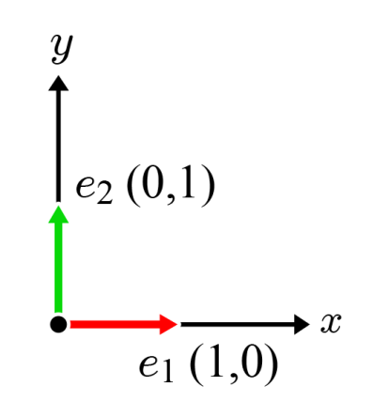
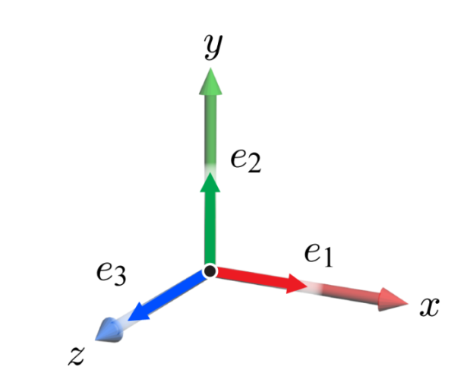
Dot Product (cont’d)
Note that, if v is a unit vector, v·v = 1.
An orthonormal basis has an interesting and useful feature.
In the 2D standard basis, {e₁, e₂}
  e₁·e₁=1 and e₂·e₂=1
  e₁·e₂=0 and e₂·e₁=0.
In the 3D standard basis, {e₁, e₂, e₃}, a similar observation is made.
  If i=j, e_{i}·e_{j}=1.
  Otherwise, e_{i}·e_{j}=0.
This feature applies to every orthonormal basis.
2-<number>

Slide 10
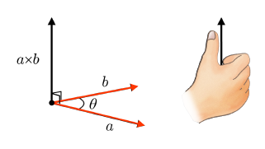
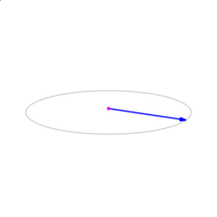
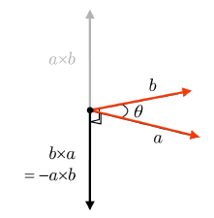
Cross Product
The cross product takes as input two 3D vectors, a and b, and returns another 3D vector which is perpendicular to both a and b. It’s denoted by a×b and its direction is defined by the right-hand rule.
The length of a×b equals the area of the parallelogram that a and b span: ‖a‖‖b‖sinθ.
The right-hand rule implies that the direction of b×a is opposite to that of a×b, i.e., b×a = -a×b, but their lengths are the same. In this sense, the cross product operation is called anti-commutative.
[wikipedia.org]
2-<number>

Slide 11


Cross Product (cont’d)
If a=(a_{x}, a_{y}, a_{z}) and b=(b_{x}, b_{y}, b_{z}), a×b=(a_{y}b_{z}-a_{z}b_{y}, a_{z}b_{x}-a_{x}b_{z}, a_{x}b_{y}-a_{y}b_{x}).
2-<number>

Slide 12
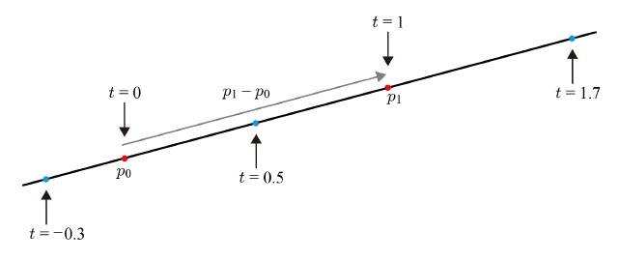
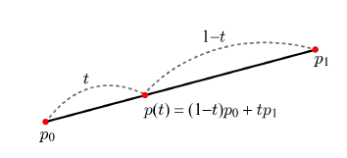
Line, Ray, and Linear Interpolation
A line defined by two end points, p₀ and p₁: p(t) = p₀ + t(p₁ - p₀)
If t is in [-∞,∞], p(t) is an infinite line. If [0,∞], p(t) is a ray, which starts from p₀ and is infinitely extended along the direction vector, p₁ - p₀ .
When t is restricted to [0,1], p(t) represents the line segment, which corresponds to the linear interpolation of p₀ and p₁.
It is a weighted sum of p₀ and p₁.
2-<number>

Slide 13
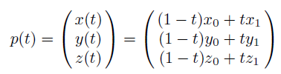


Line, Ray, and Linear Interpolation (cont’d)
Linear interpolation in 3D space
Whatever attributes are associated with the end points, they can be linearly interpolated. Suppose that the endpoints are associated with colors c₀ and c₁, respectively, where c₀ = (R₀, G₀, B₀) and c₁ = (R₁, G₁, B₁). Then, the color c(t) is defined as follows:
2-<number>

